Slide 1


Comparing the Loss of Honey Bee Colonies by Reason of Loss and by US Regions
Cristina Iacob

Slide 2
Honey Bees Facts
Bees play a vital role in sustaining various ecosystems on the planet
Bees pollinate over ¾ of the plants that produce 90% of the world’s food
The number of beekepers have increased by 62% since 2010
In 2006 honey bees were listed among the endangered species
In 2017 Pennsylvania enacted the Pollinator Protection Plan, to protect the bee population
Sadly, over the past 15 years, colonies of bees have been in a strong decline,
the main 2 causes being the identified as the colony collapse disorder and the dead-out
phenomenon
Colony collapse occurs when the worker bees are lost, leaving behind the queen, the
nursing bees caring for the brood and plenty of food in the hive
Colony dead-out occurs when an entire bee colony has died, most often due to parasites, pathogens, pesticides or poor nutrition

Slide 3
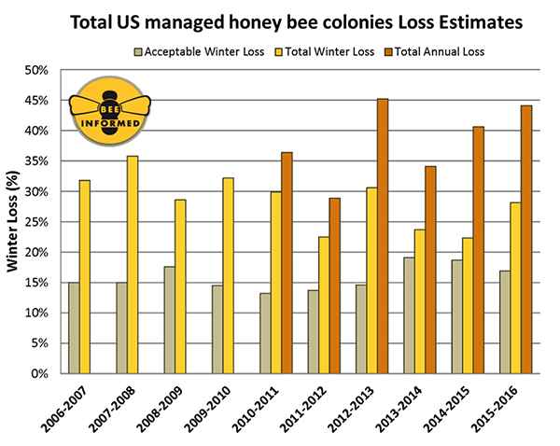
Research Questions
As per studies done at https://beeinformed.org/
nation’s beekepers lost 44% of bees in 2015-16
For this analysis the goal is to identify for the years 2019 & 2020:
Is there a difference between the loss of honey bee colonies by colony collapse disorder (CCD) and the loss due to dead-out phenomenon ?
Is there a significant difference between the loss of honey bee colonies by US agricultural regions ?
Notes:
test

Slide 4
Audience
This research is intended for:
commercial beekepers, bee hobbyists and biologists.
anybody involved in defining measures to mitigate the honey bees colonies loss and restore the bee population to sustainable levels.
anybody involved in honey business and interested in learning about the history of bees as well as the future
The research notebook can be found at
https://github.com/cristina-iacob/Save-The-Bees

Slide 5
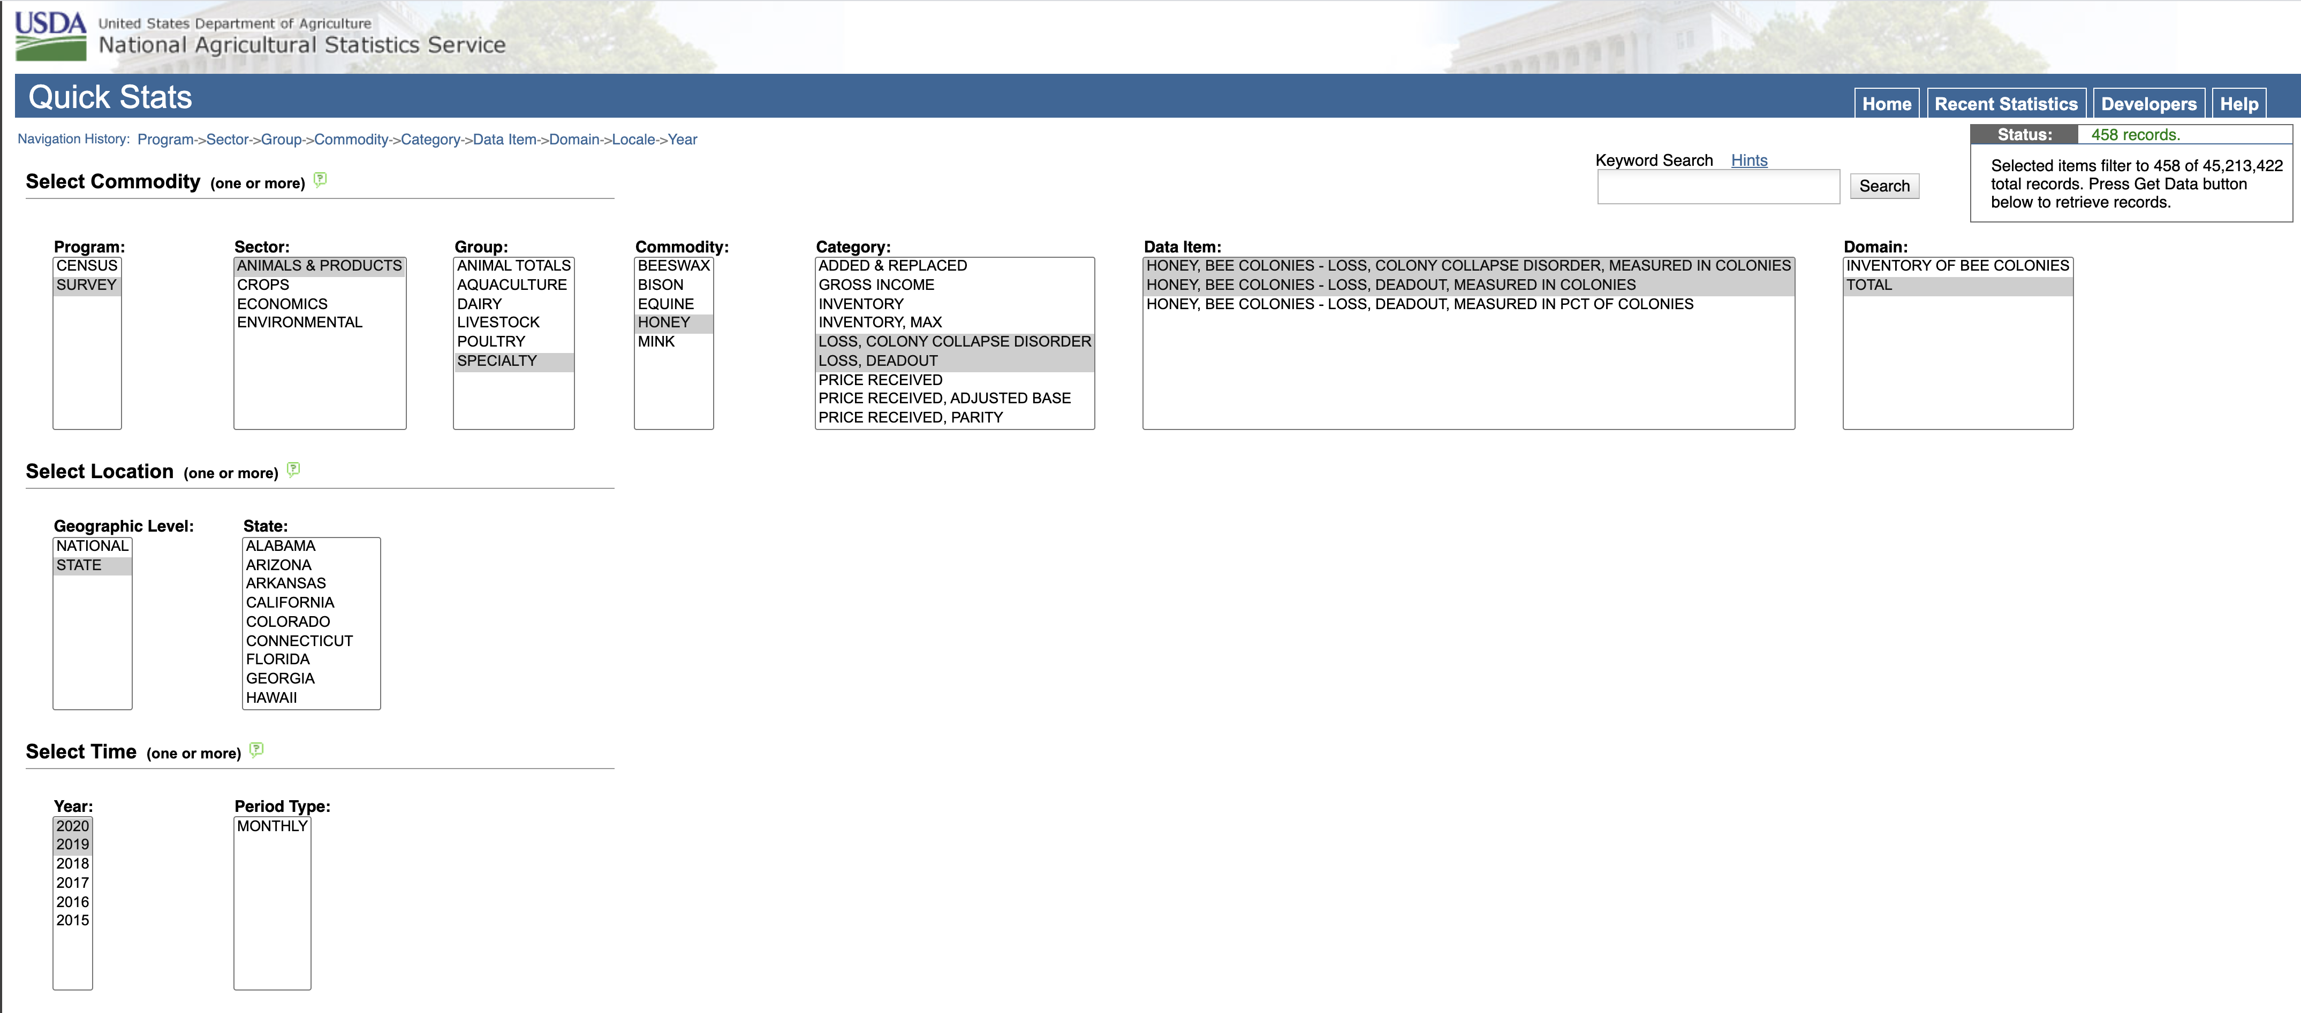
Exploring the Data
Data was sourced from: https://quickstats.nass.usda.gov/
with the following search criteria:
Data for State Abbreviations: https://www2.census.gov/geo/docs/reference/codes/files/national_county.txt
Data for Agricultural Regions: https://en.wikipedia.org/wiki/List_of_regions_of_the_United_States
Notes:
test

Slide 6
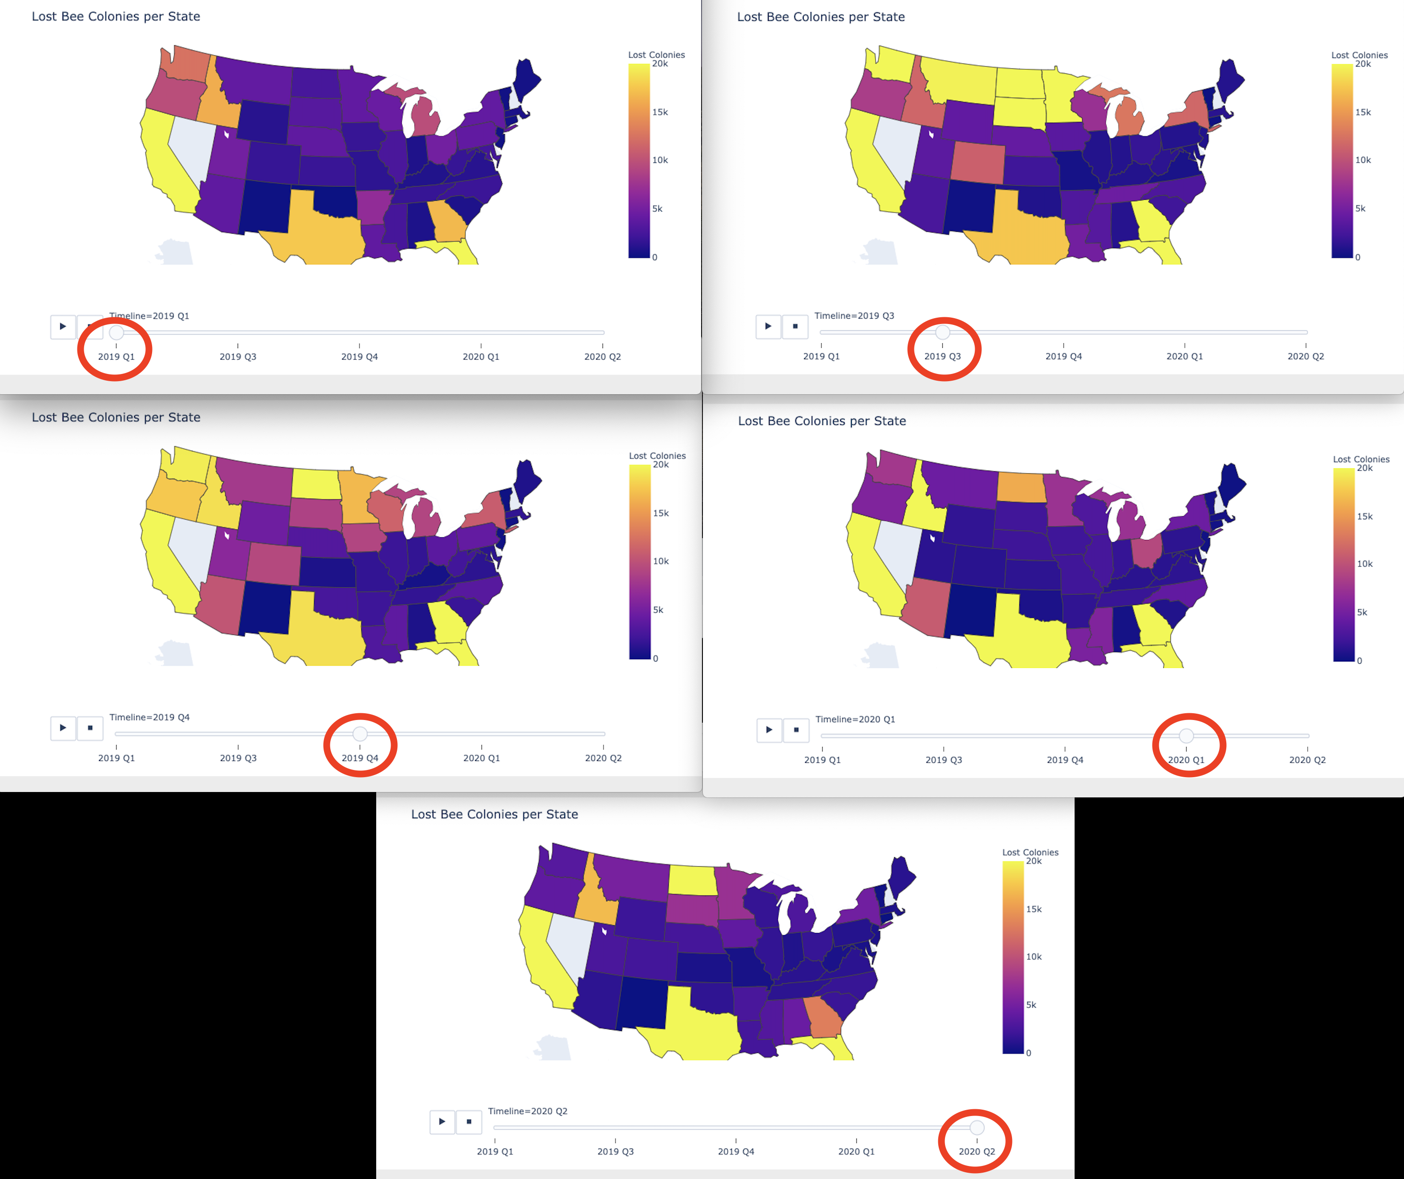
Timeline for Lost Colonies per State
Notes:
test

Slide 7
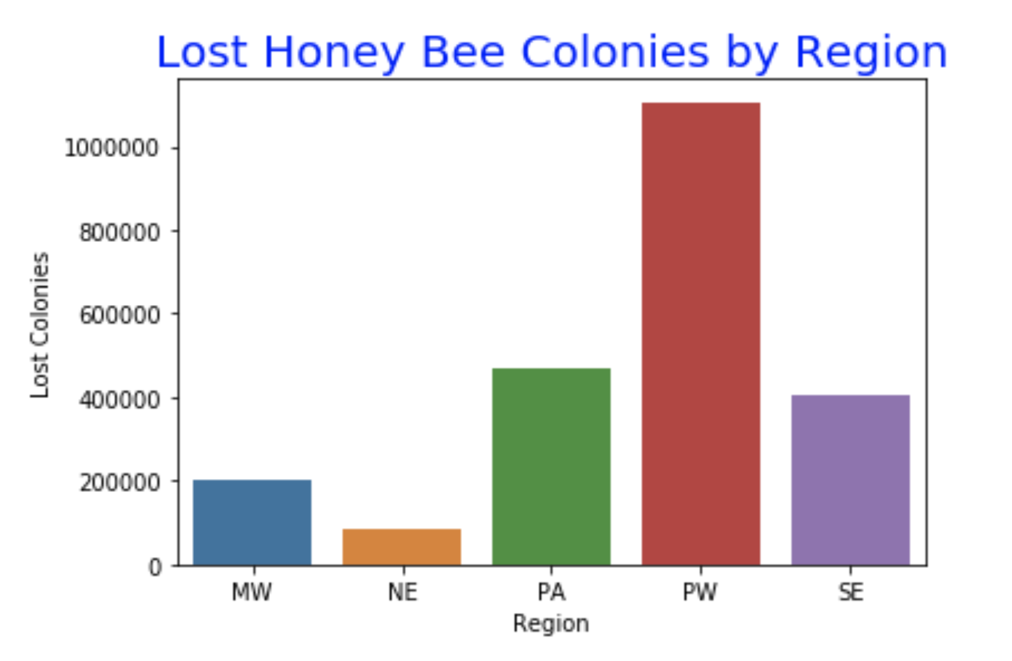
Total Honey Bee Colonies Lost per Region

Slide 8
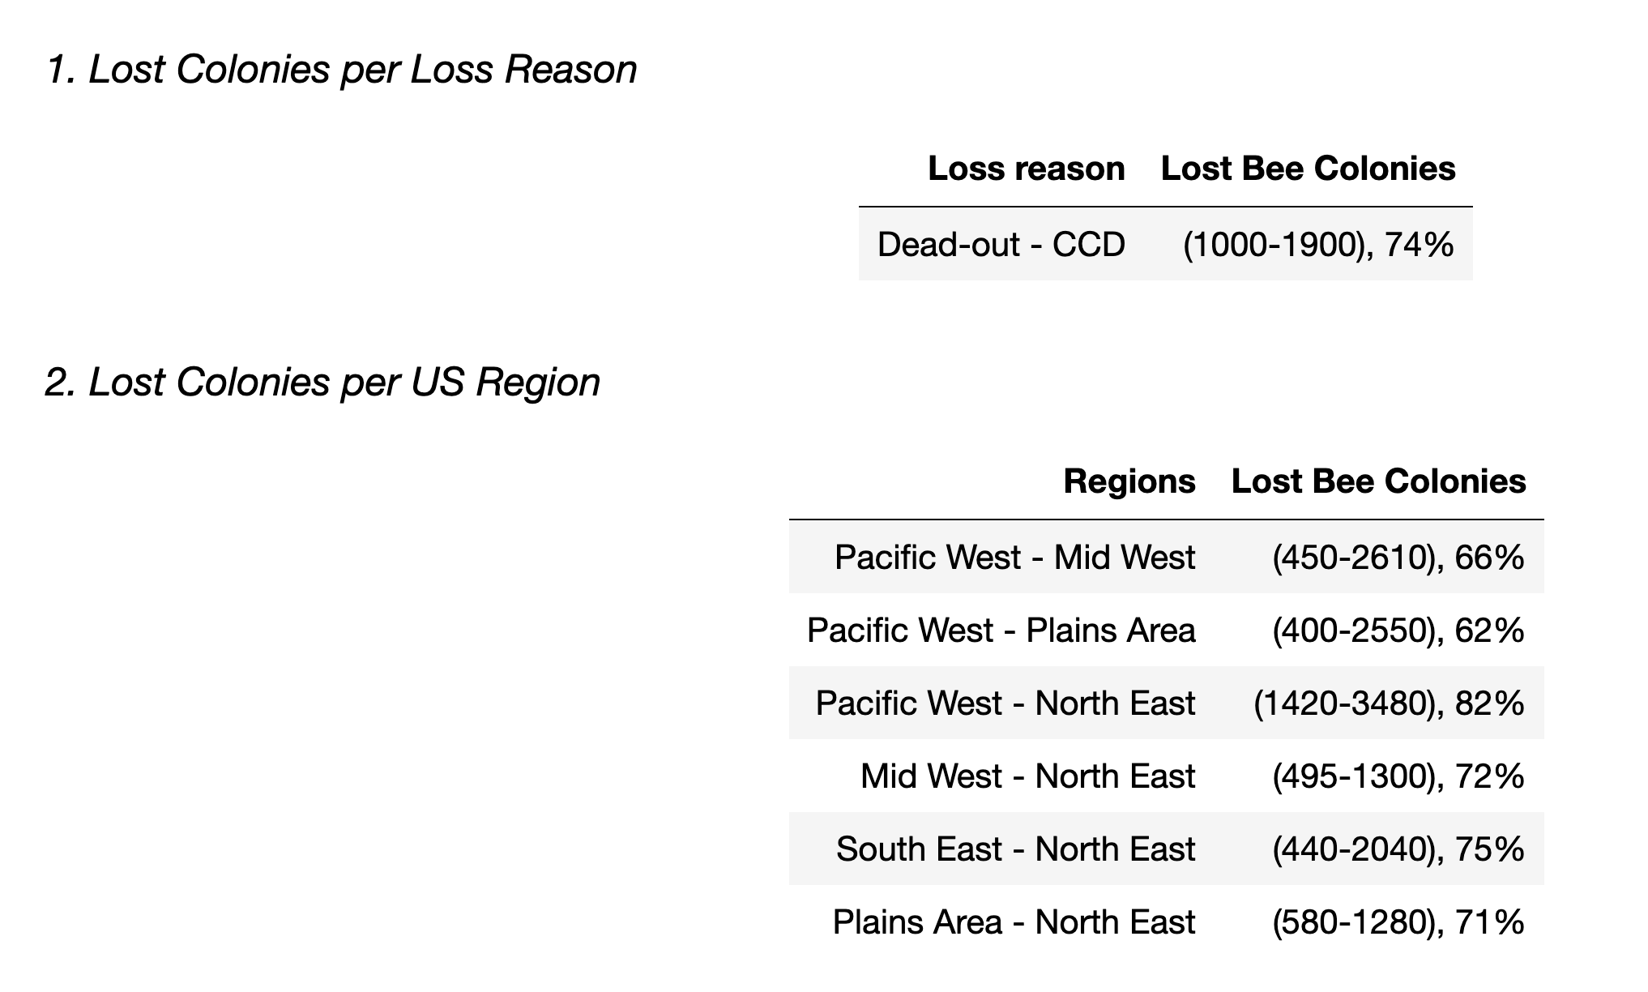
Results

Slide 9
Notes & Recommendations
Data Limitations
Unique dataset - contains the only available data about the loss of bee colonies due to CCD
Data is the most recent available however missing Q2 of 2019
Missing data for several states
Larger number of data points would be more relevant for the analysis
Recommendations
Unique dataset - contains the only available data about the loss of bee colonies due to CCD
Data is the most recent available however missing Q2 of 2019
Missing data for several states
Larger number of data points would be more relevant for the analysis
What’s next?
Investigate if anything changes when combining the 2 groups: Region and Loss Reason
Investigate the total loss per quarters, when more data will be available

Slide 10

Questions?

Slide 11

Thank you!

